Slide 1
Software Defined Networks

Slide 2
Why SDN ?
“Because there is no army that can hold back an economic principle whose time has come.”
– John Donovan, AT&T
SDN is “The Future of Networking, and the Past of Protocols”
– Scott Shenker

Slide 3



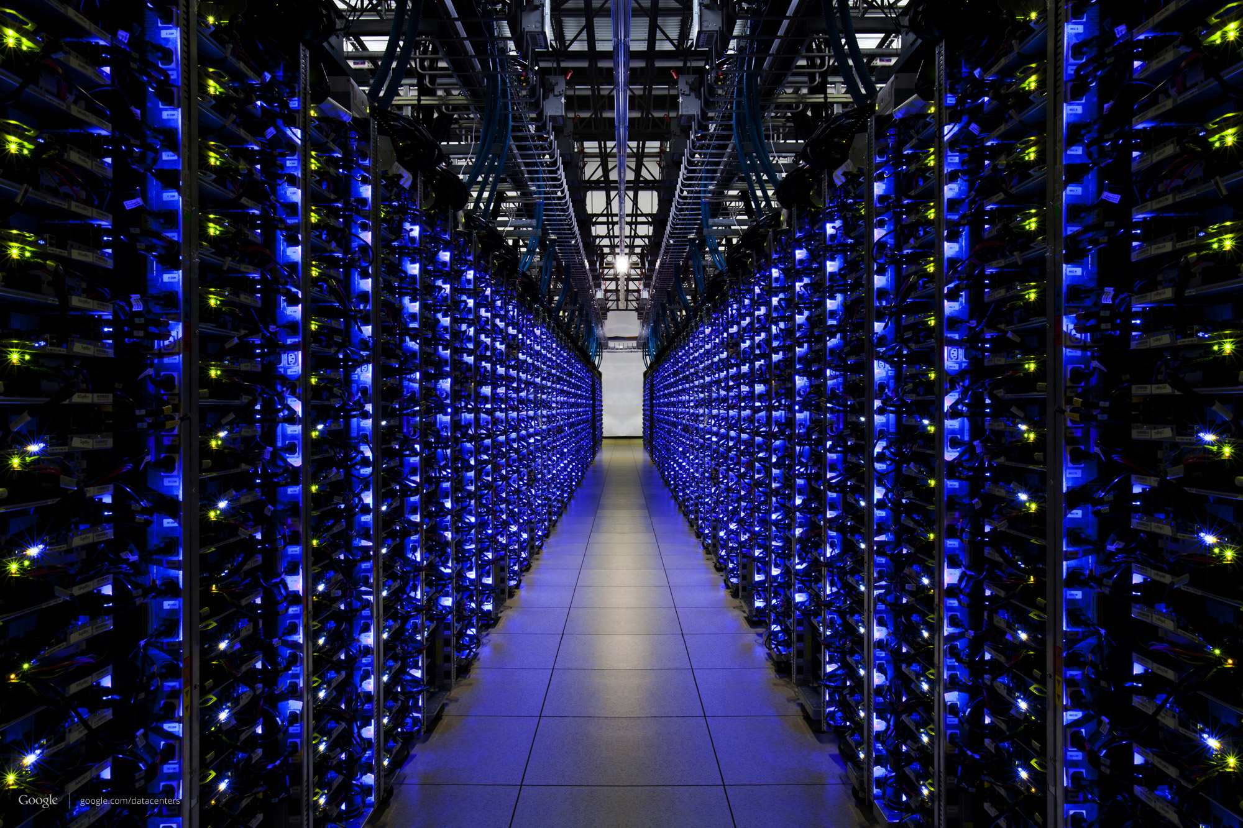
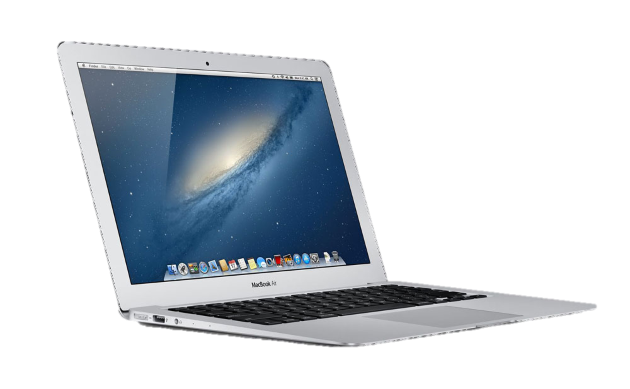

Slide 4
Network
Router
Link

Slide 5
Network Path
Data
Address
Data

Slide 6
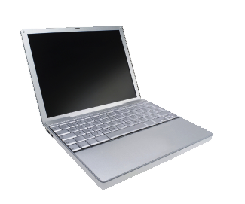
Data
Data

Slide 7
Packets may be corrupted
?!%%*
Data
Data

Slide 8
Packets may arrive out of order
1
2

Slide 9
Packets may be duplicated
Duplicate
Data
Data

Slide 10
They may not arrive at all
Data
Data
Full

Slide 11
Why was an Internet so simple and dumb so successful?

Slide 12
The Internet was successful because it was simple and dumb

Slide 13
Application
Application
Transport
“TCP”
Reliable end-to-end delivery
Transport
Network
“IP”
Unreliable datagram service
Network
Data

Slide 14
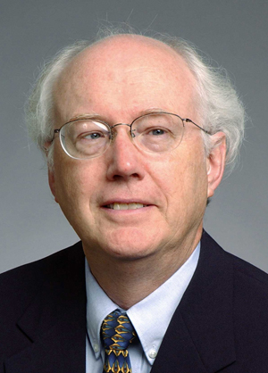
David D. Clark
Chief Protocol Architect, Internet
1981 - 1989

Slide 15
Architectural Principles
1
Dumb and simple
i
Streamlined, fast, low-cost, easy to maintain, infrequent upgrades.
Reliable in-order delivery can be built on top, at the end-points.
i
Intelligent end-points (computers).
2

Slide 16
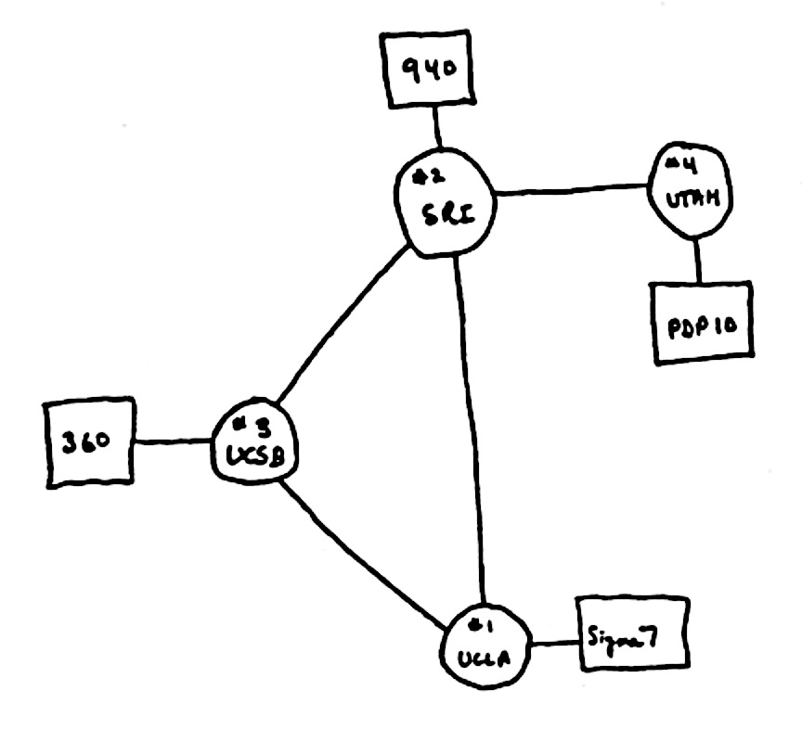
Architectural Principles
3
Decentralized control
i
Rapid organic growth
1969

Slide 17
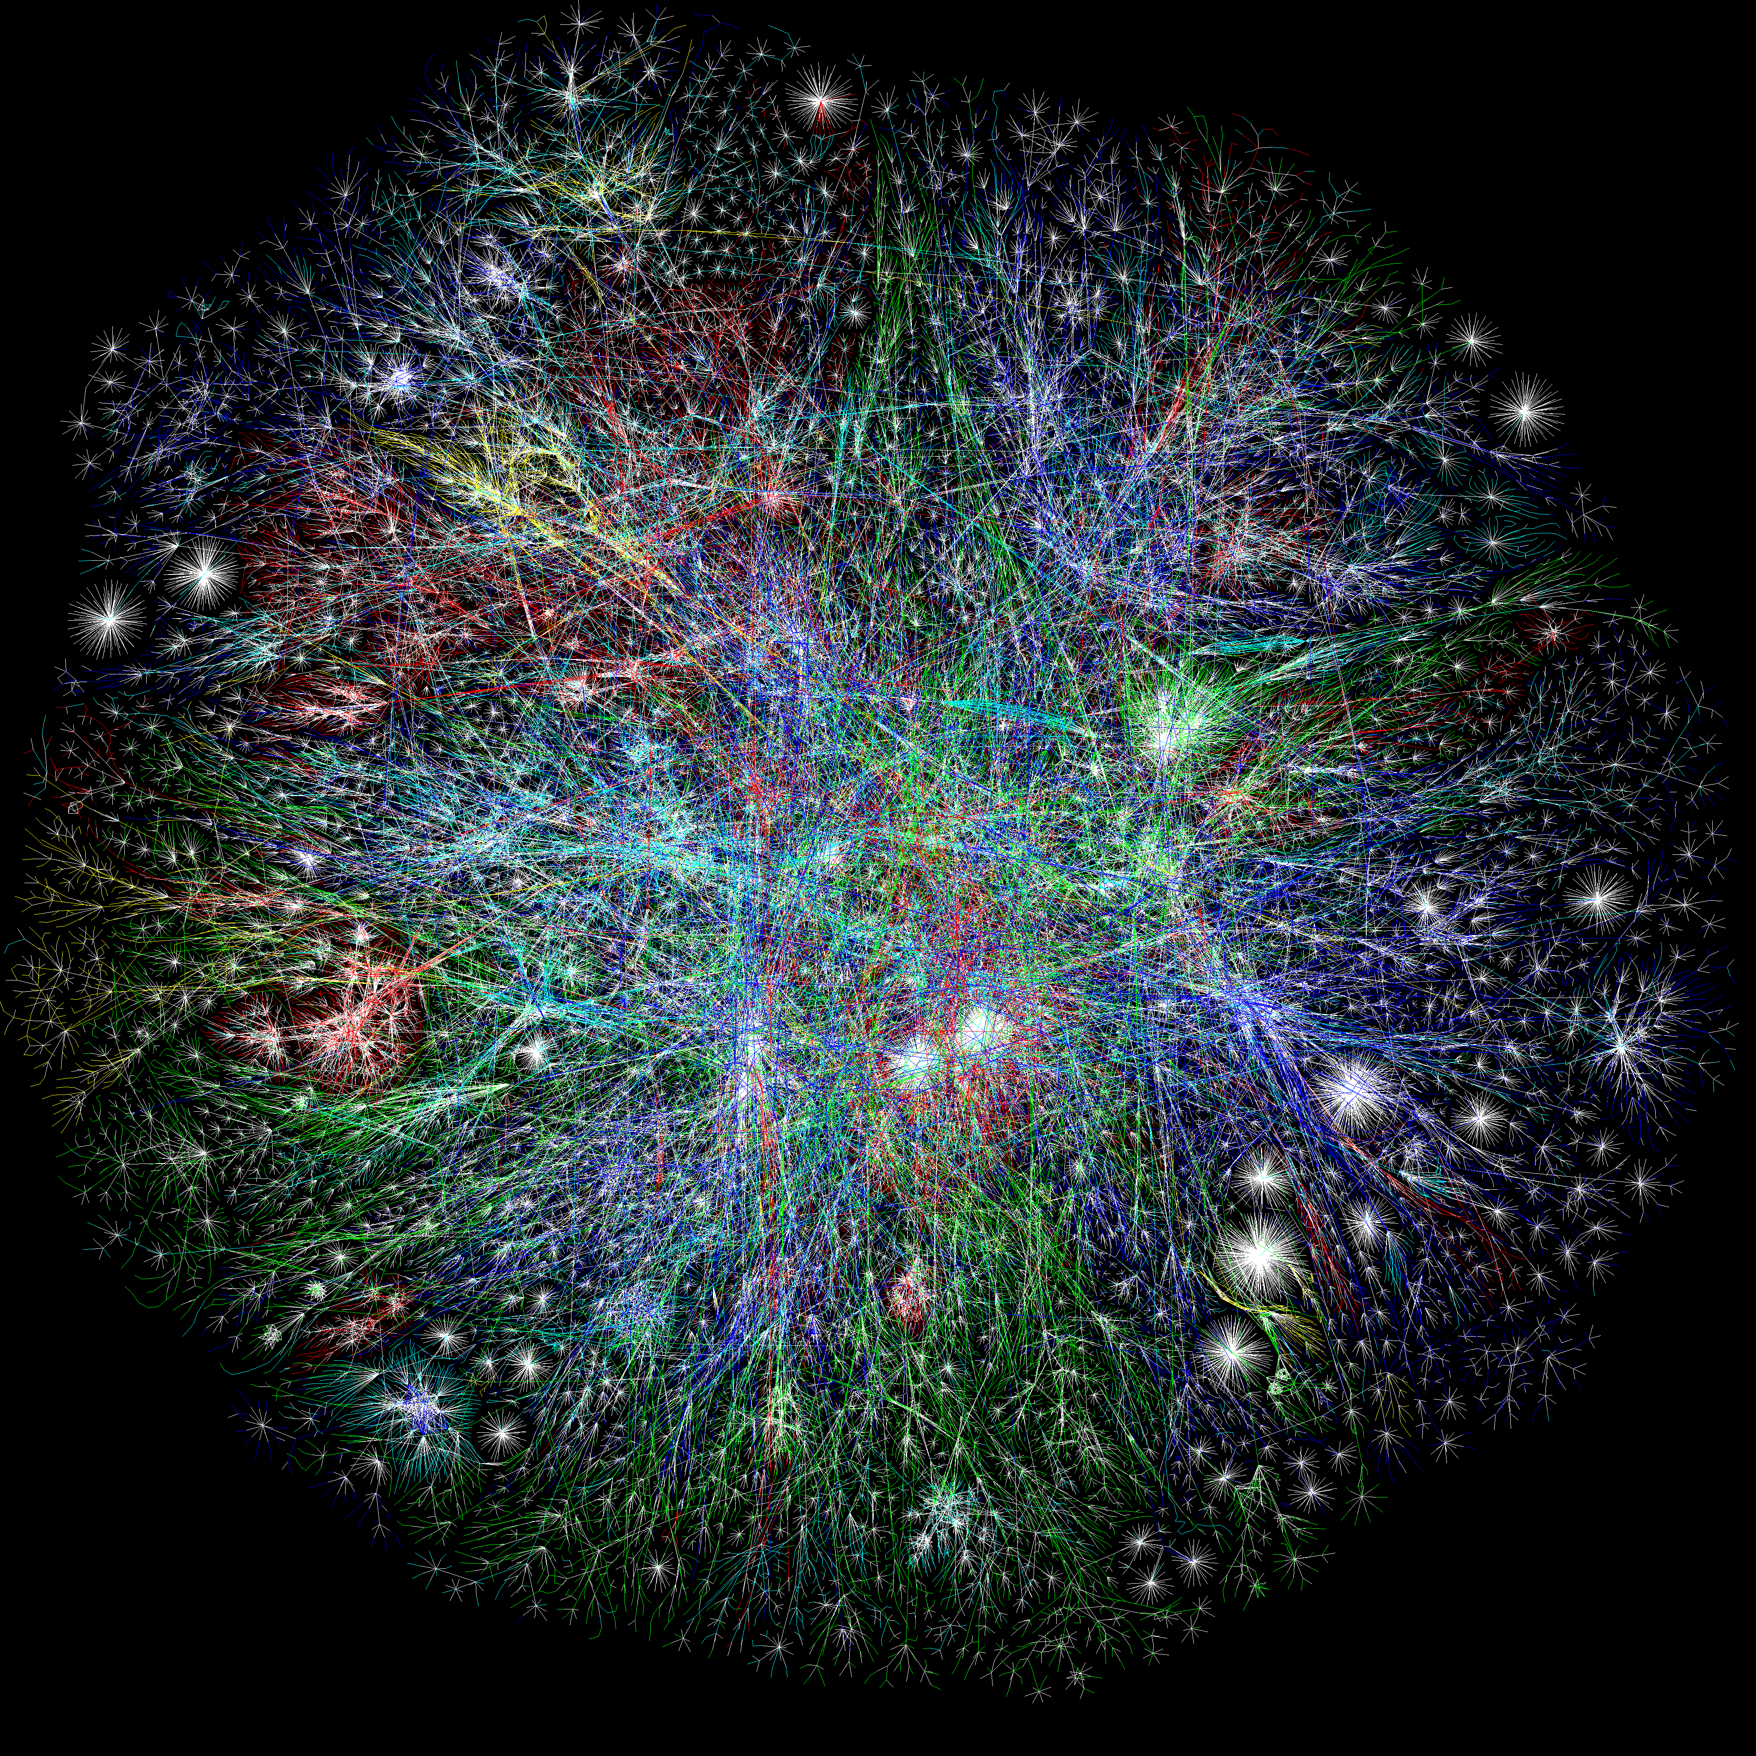
The Opte Project

Slide 18
Computers connected to Internet
1 Billion
Millions
Source: ISC

Slide 19
Summary so far
The Internet was deliberately designed …
To be simple and streamlined.
To have decentralized control: Lots of individually controlled pieces.
Which led to …
Explosive organic growth of the Internet.
A great business for companies selling routers.
simple and streamlined
A great business

Slide 20
Number of published Internet Standards

Slide 21
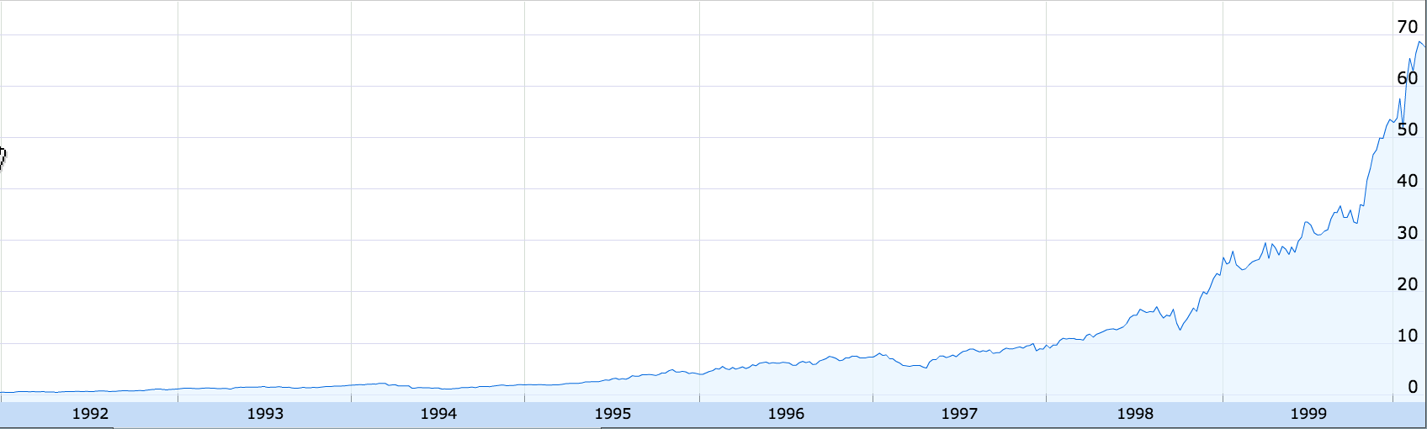
Cisco Stock Price
200x
1991
1999
Google Finance

Slide 22
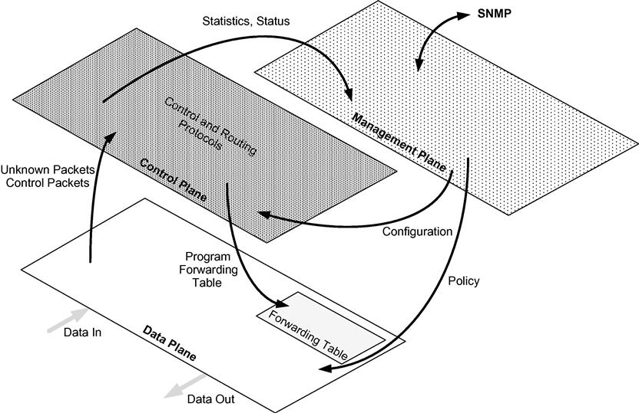
Traditional Switch Architecture
The vast majority of packets handled by the switch are only touched by the data plane. The data plane consists of the various ports that are used for the reception and transmission of packets and a forwarding table with its associated logic. The data plane assumes responsibility for packet buffering, packet scheduling, header modification and forwarding.
Not all packets can be handled in that way, sometimes simply because their information is not yet entered into the table, or because they belong to a control protocol that must be processed by the control plane. The principal role of the control plane is to keep current the information in the forwarding table so that the data plane can independently handle as high a percentage of the traffic as possible. The control plane is responsible for processing a number of different control protocols that may affect the forwarding table, depending on the configuration and type of switch. These control protocols are jointly responsible for managing the active topology of the network.
Data, Control and Management Planes
The third plane depicted above is the management plane. Network administrators configure and monitor the switch through this plane, which in turn extracts information from or modifies data in the control and data planes as appropriate. The network administrators use some form of network management system to communicate to the management plane in a switch.

Slide 23
Early Internet (1980 ~ 1990)
Software-Based Routing and Bridging
Connection-oriented packet switching, such as X.25 and ATM,
The connectionless Internet architecture TCP/IP
Multiple competing Layer 2 technologies, e.g., were prevalent, including Token Ring, Fiber Distributed Data Interface (FDDI).
Different speeds and physical media versions of the original Ethernet.
Layer 2 bridges served as a mechanism to forward frames between LANs belonging to same as well as disparate layer two technologies.
Advent of Software based routers that routes packets between same and disparate Layer 3 technolgies.

Slide 24
Hardware based Routing and Switching
Demand for increased speed brought about concomitant advances in the performance of these network devices.
Demand for higher storage brought the requirement of server blades.
Advent of hardware based lookup of Forwarding Tables.
The hardware acceleration in packet switching was made possible via the use of application-specific integrated circuits (ASICs) to perform high-speed hashing functions for table lookups. Also the advances in content-addressable memory (CAM) technology made it possible to perform very high-speed lookups using destination address fields to find the output interface for high-speed packet forwarding.

Slide 25
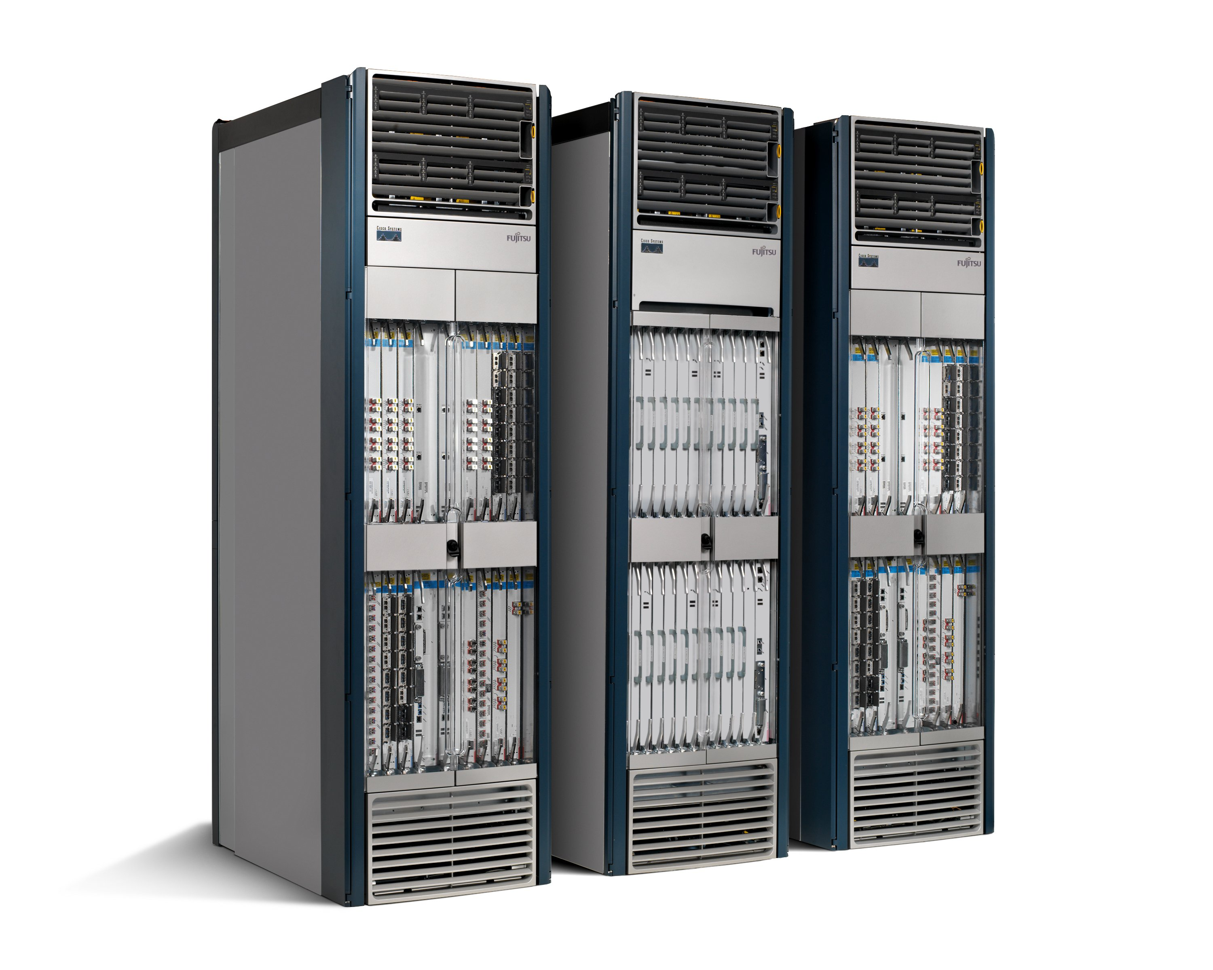
50+ million lines of code
Software
Tens of billions of transistors
Hardware
Routers are fragile and insecure
Bloated and power hungry
Like the computer mainframes of the 1980s

Slide 26
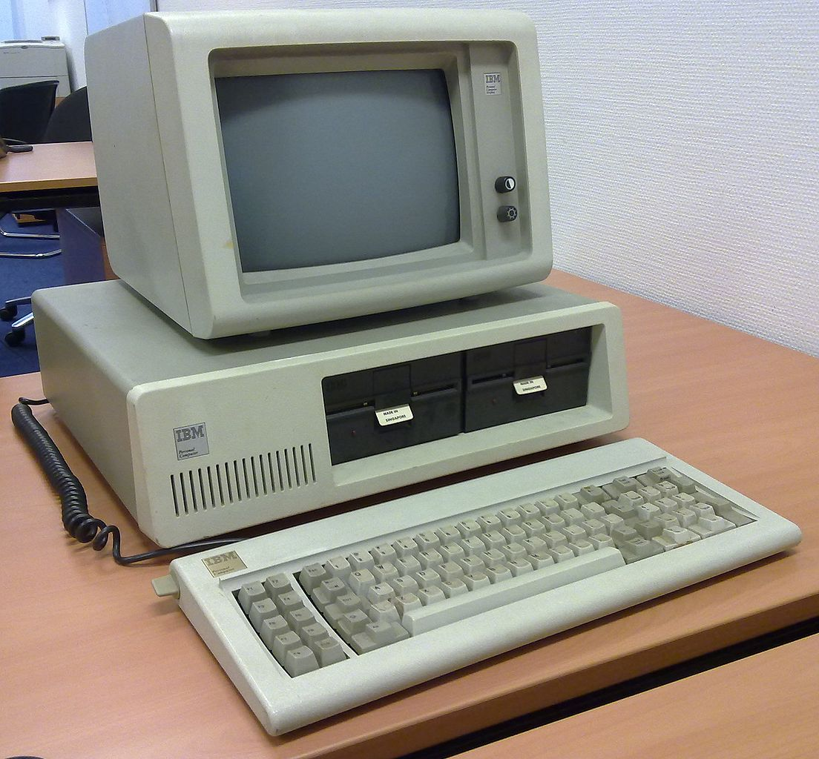
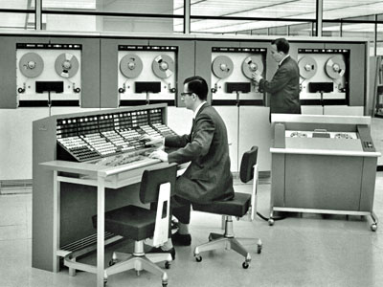
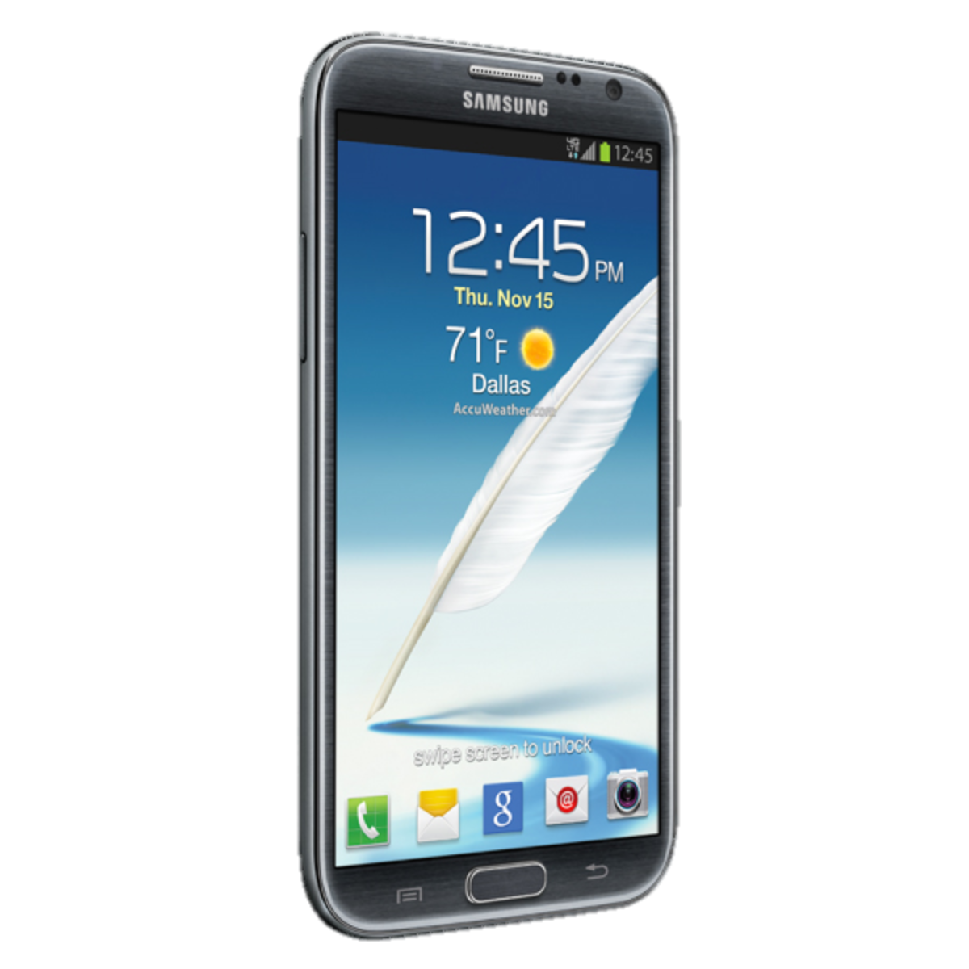
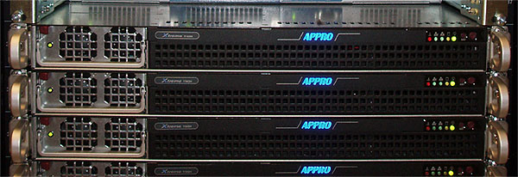
Computers became easier to use and more reliable…
2000s
1960s
Now
1980s
2000s
1960s
Now
1980s

Slide 27
Networks became harder to manage and less reliable…
Now
Now

Slide 28
Making Software Work
Specification
$10B tool business supports a $300B S/W industry
Functional Description (Code)
Testbench
Static Code Analysis
Invariant
Checker
Model Checking
100s of Books
>100,000 Papers
10s of Classes
Run-time Checker
Interactive Debugger

Slide 29
Making Networks Work (Today)
traceroute, ping, tcpdump, SNMP, Netflow
…. er, that’s about it.

Slide 30
Networks are kept working by “Masters of Complexity”
A handful of books
Almost no papers

Slide 31
Complexity means networks have become too expensive to own and operate

Slide 32
Example 1: Internet Service Providers
Global IP traffic growing 40-50% per year
End-customer monthly bill remains unchanged
Therefore, cost of ownership needs to reduce 40-50% per Gb/s per year
But in practice, reduces by <20% per year
Revenue
£20/month
Total cost
Growth in traffic
time

Slide 33
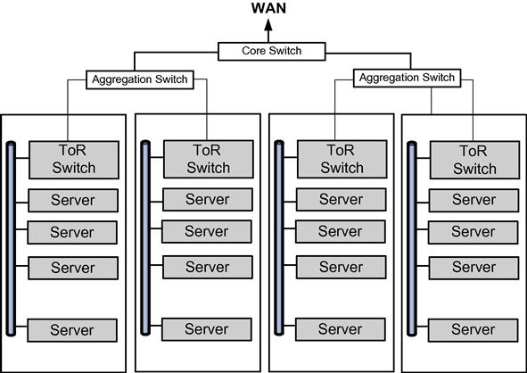
Data Center
Because of the large numbers of these servers, they were physically arranged into highly organized rows of racks of servers. Over time, the demand for efficiency drove the migration of individual server computers into server blades in densely packed racks. Racks of compute-servers were hierarchically organized such that top-of-rack (ToR) switches provided the networking within the rack and the inter-rack interface capability.
The sheer numbers of computers in the data center evolved rapidly. Data centers are being built now that will accommodate over 120,000 physical servers. State-of-the-art physical servers can conceivably host 20 virtual machines (VMs) per physical server. This means that the internal network in such a data center would interconnect 2,400,000 hosts!
The sheer scale of these mega data centers in terms of nodes and links creates a network management challenge different from those encountered previously. Network management systems designed for carrier public networks or large corporate intranets simply cannot scale to these numbers. A new network management paradigm is needed.

Slide 34
Data Center Configuration
Although these data centers exist in order to support interaction with the turbulent world outside their walls, current research predicts that by 2016 80% of the traffic in data centers will be East-West traffic. East-West traffic is composed of packets sent by one host in a data center to another host in that same data center. Analogously, North-South traffic is traffic entering (leaving) the data center from (to) the outside world. This increasing preponderance of East-West traffic does not benefit from the overhead and complexities that have evolved in traditional network switches to provide just the decentralized survivability.

Slide 35

Example 2: Data Center Owner
Cost
400,000 servers
20,000 switches
$5k per switch = $100M
$1k commodity switch = $20M
Savings in 10 data centers = $800M
Control
More flexible control
Tailor network as needed
Quickly improve and innovate

Slide 36
Chapter 2: Lessons from the computer industry

Slide 37
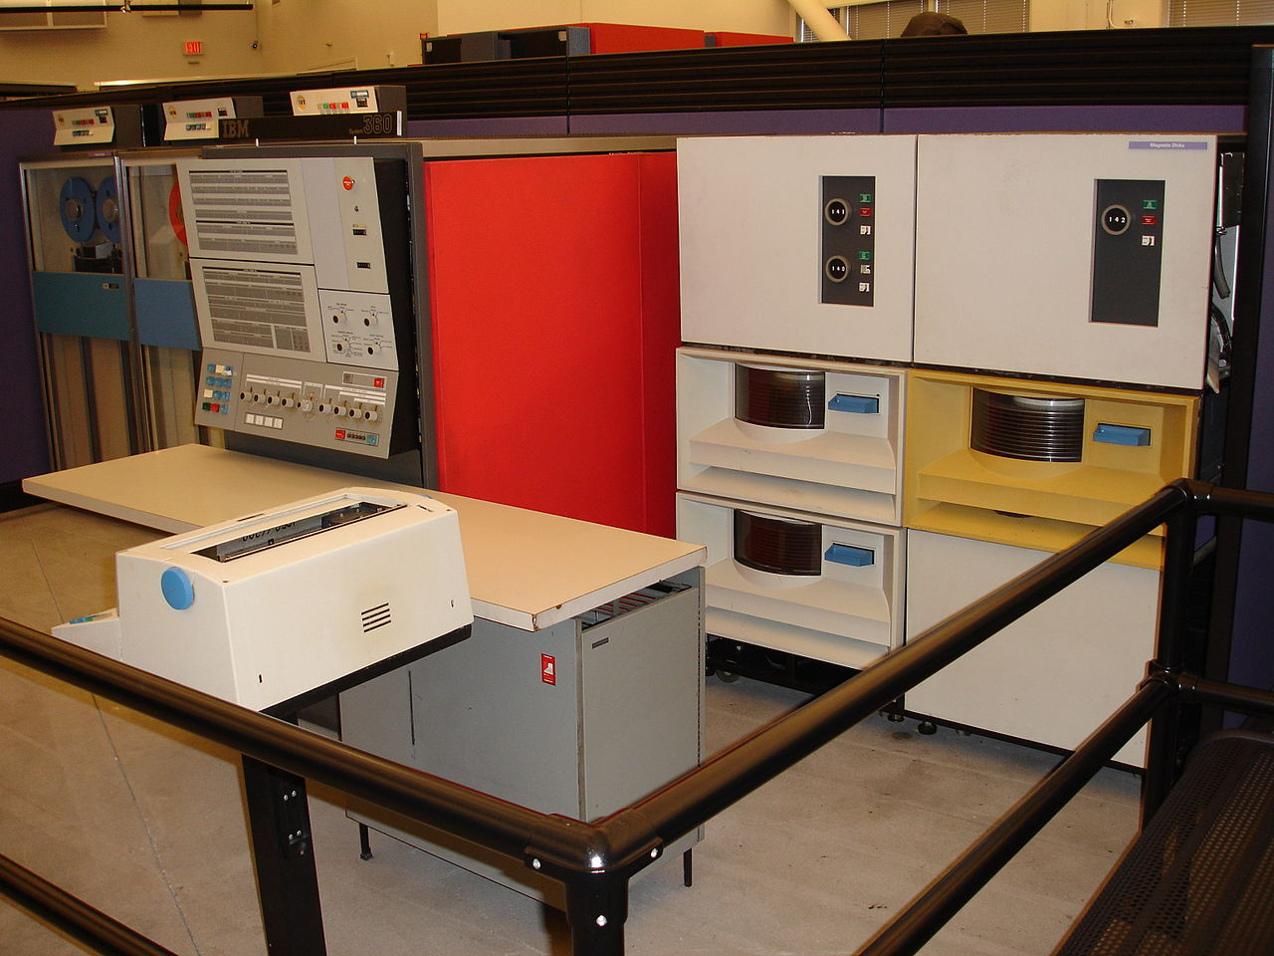
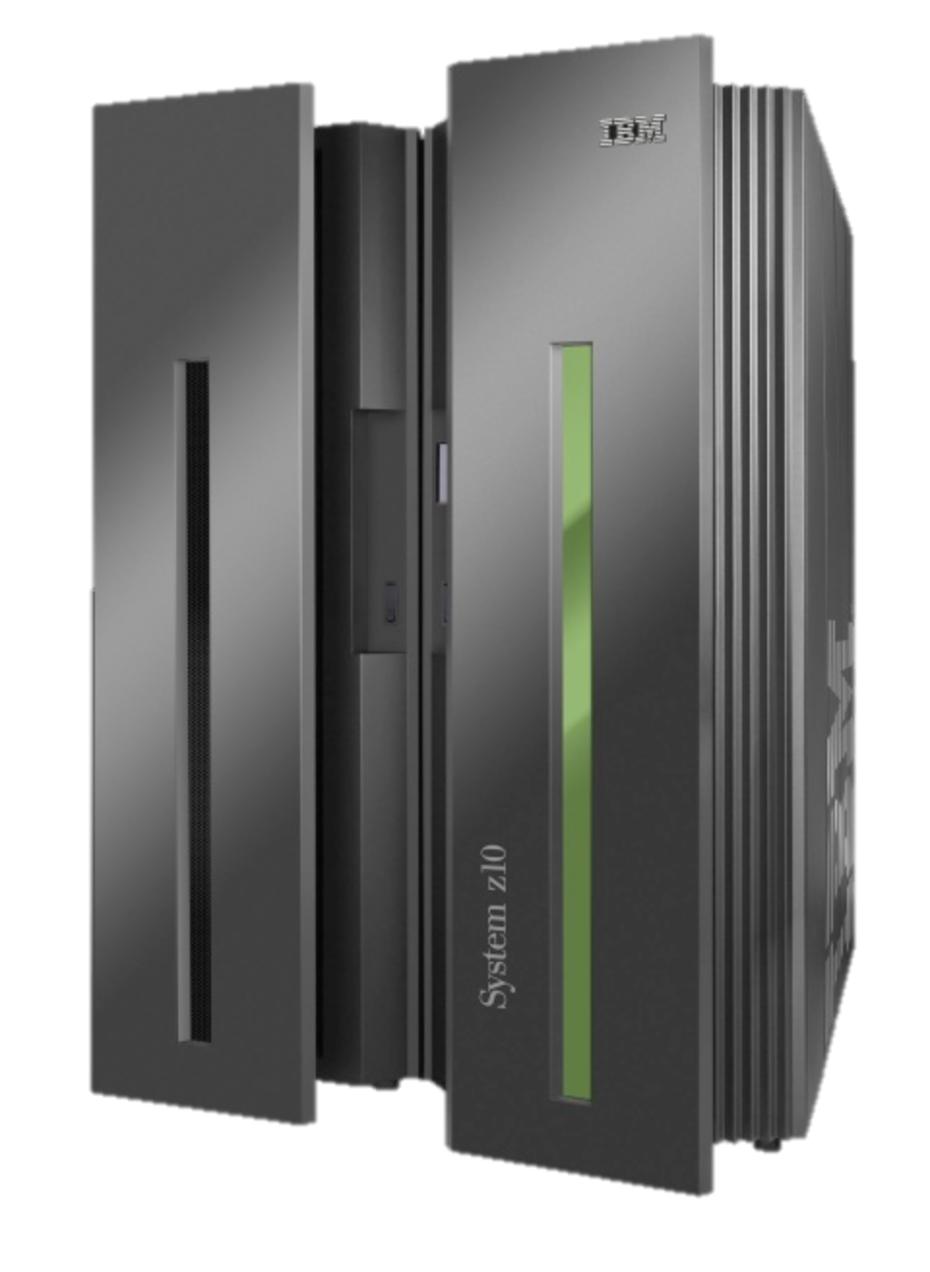
1964-1979: The mainframe computer

Slide 38
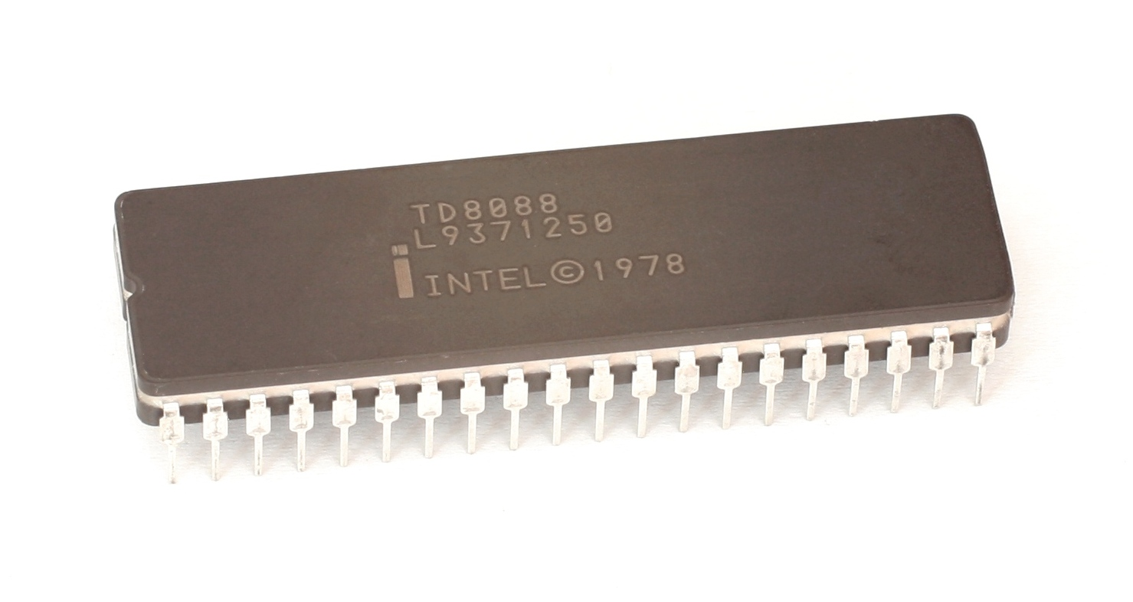
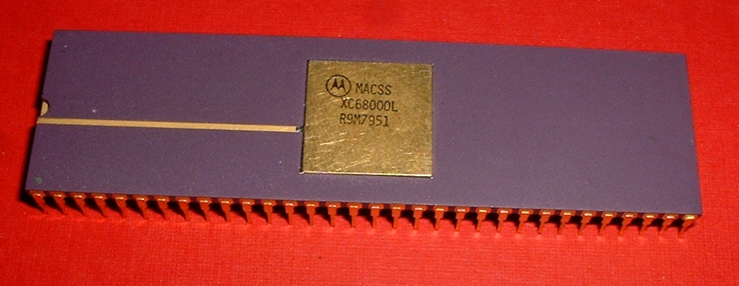
1979: The microprocessor
Intel 8088
Motorola 68000

Slide 39
1981: The personal computer
IBM PC

Slide 40
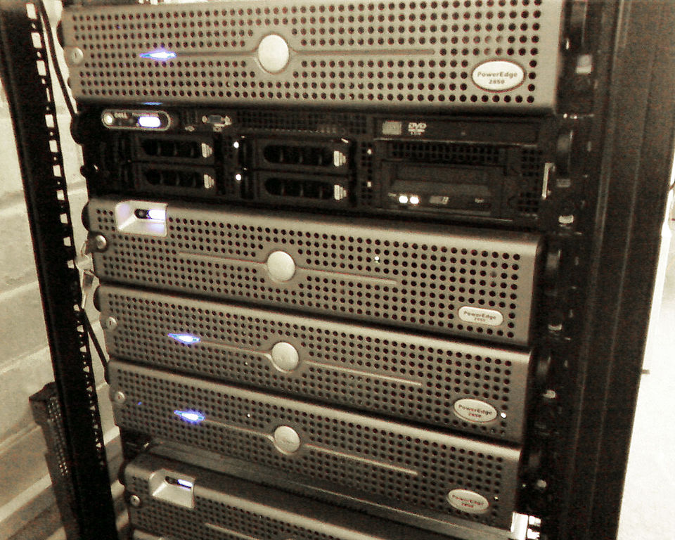
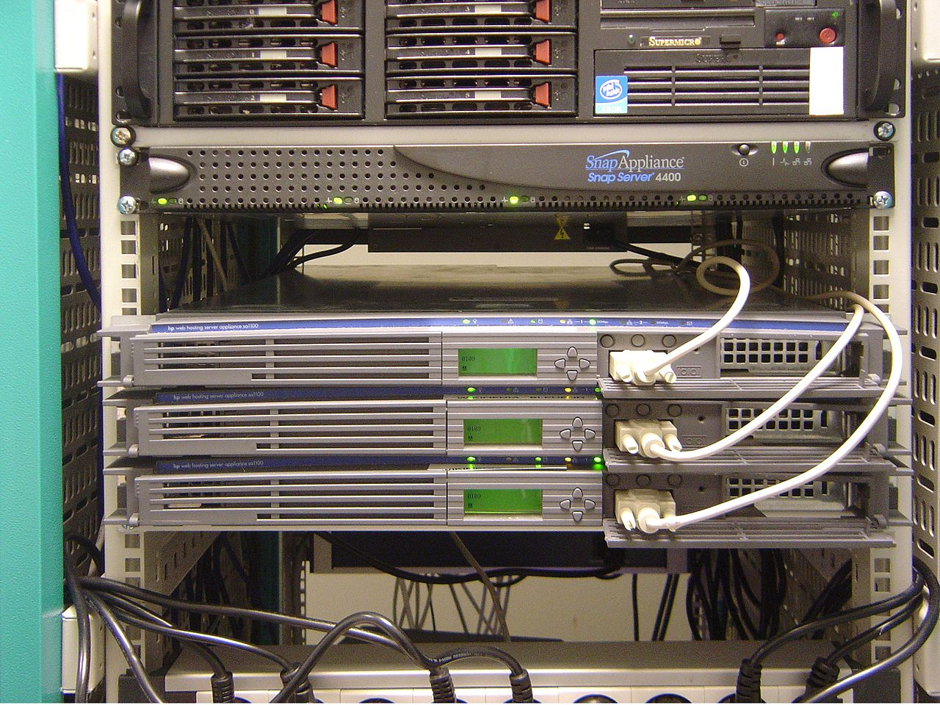
2000: Rack-mounted Servers
Dell Servers
HP Servers

Slide 41
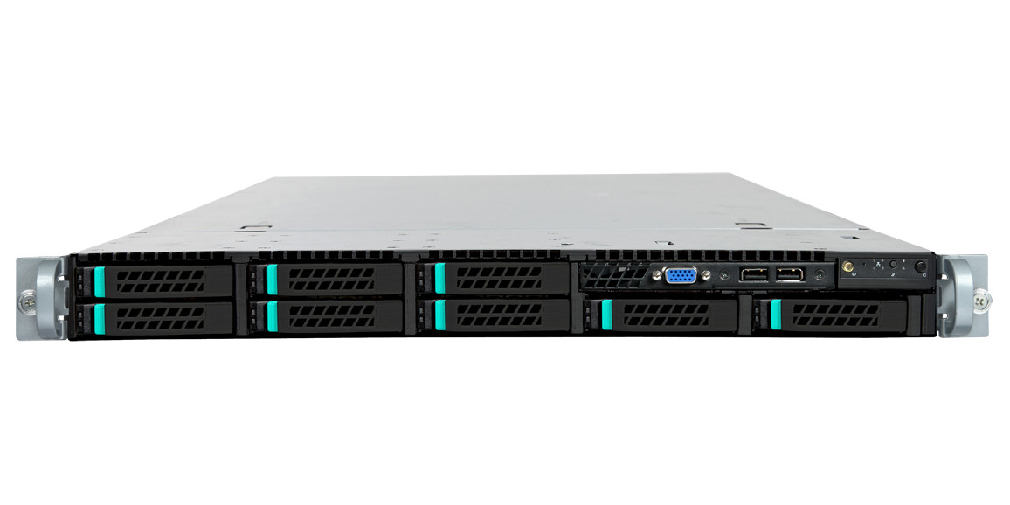

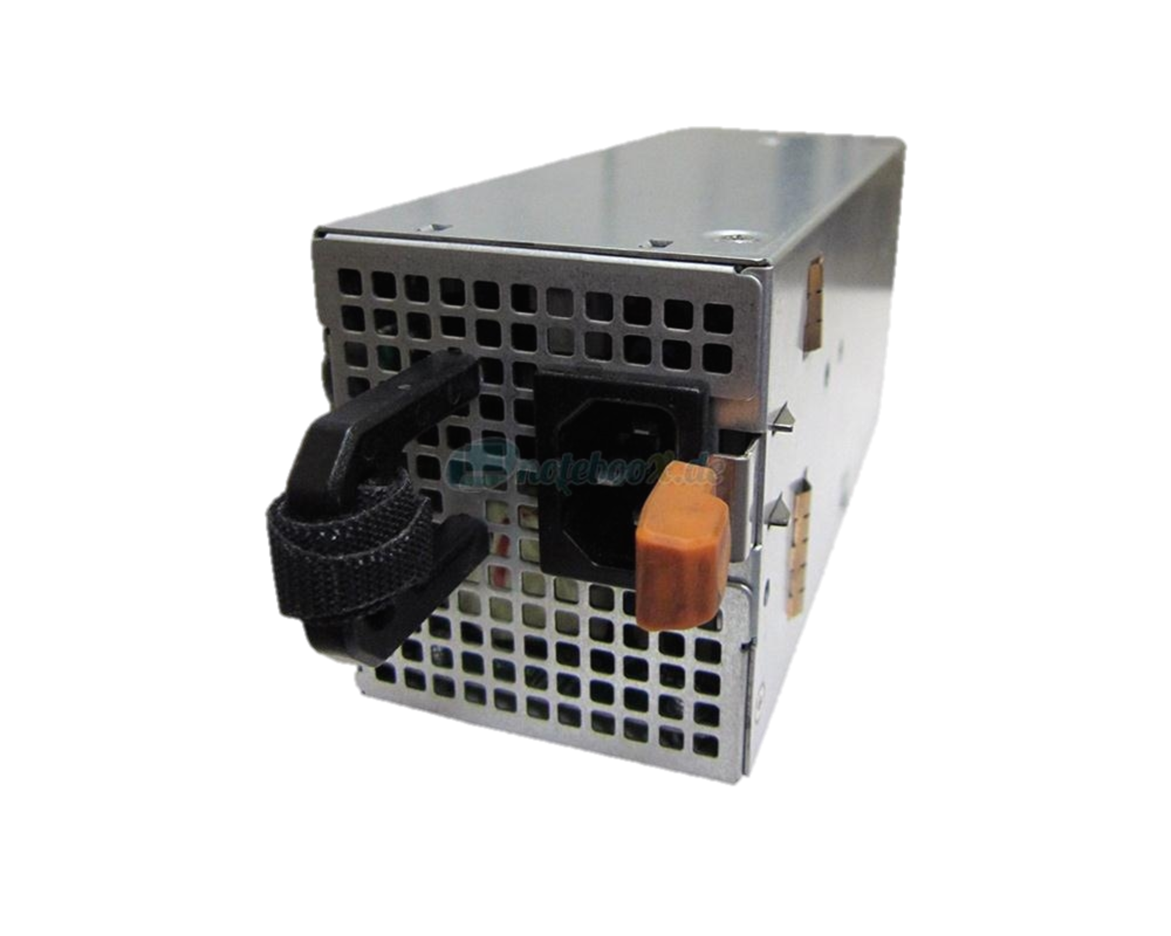
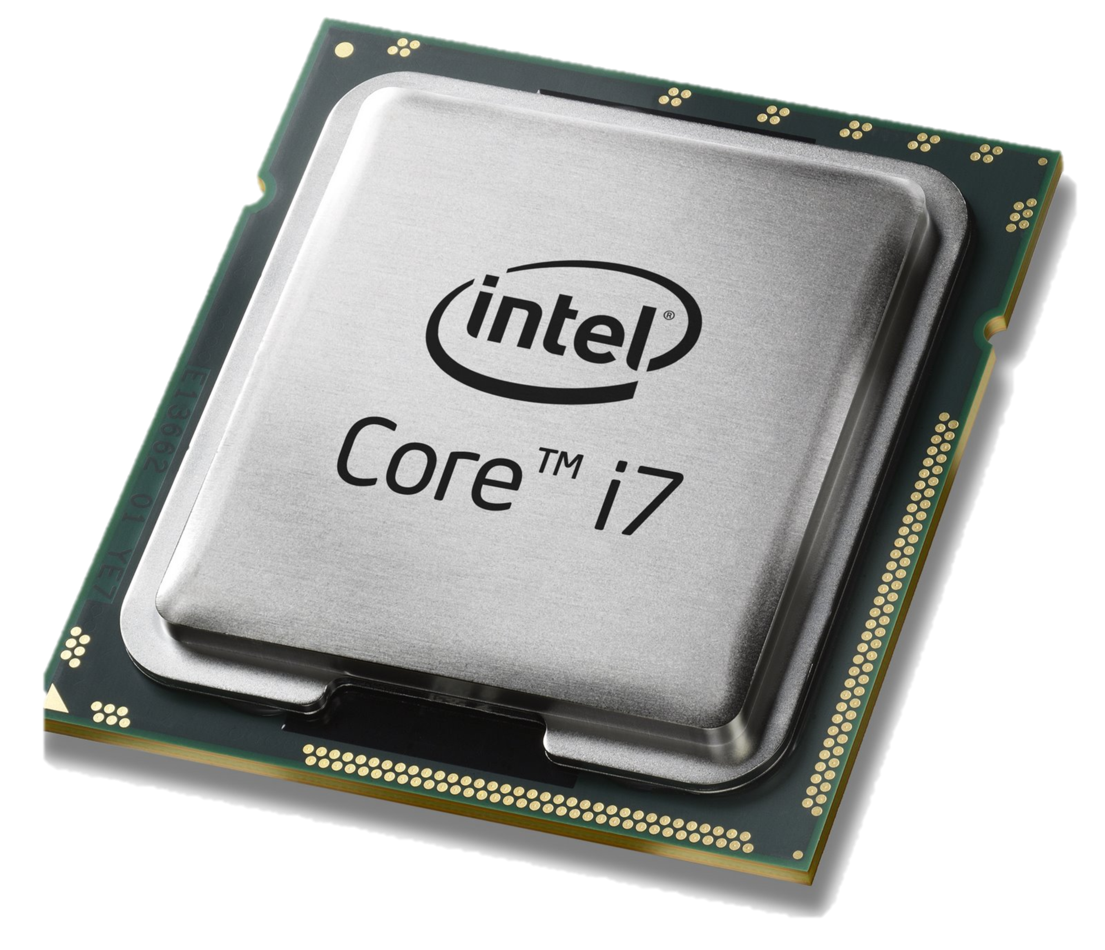
2005: The whitebox server
Sheet metal
DRAM

Slide 42
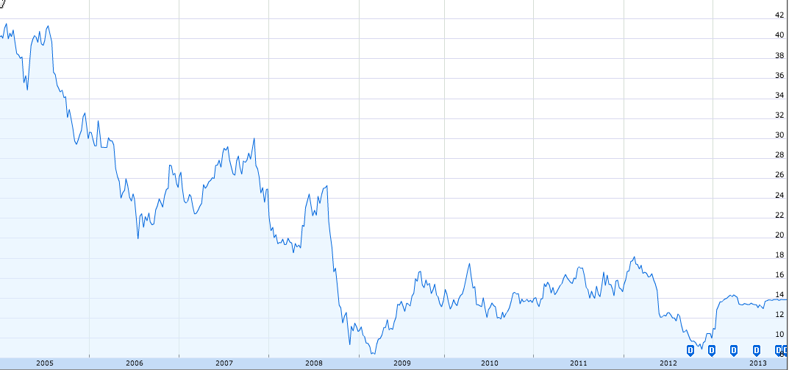
Dell Stock Price
$42
$14
2005
2013
Google Finance
Notes:
Dell stock price from google finance.

Slide 43
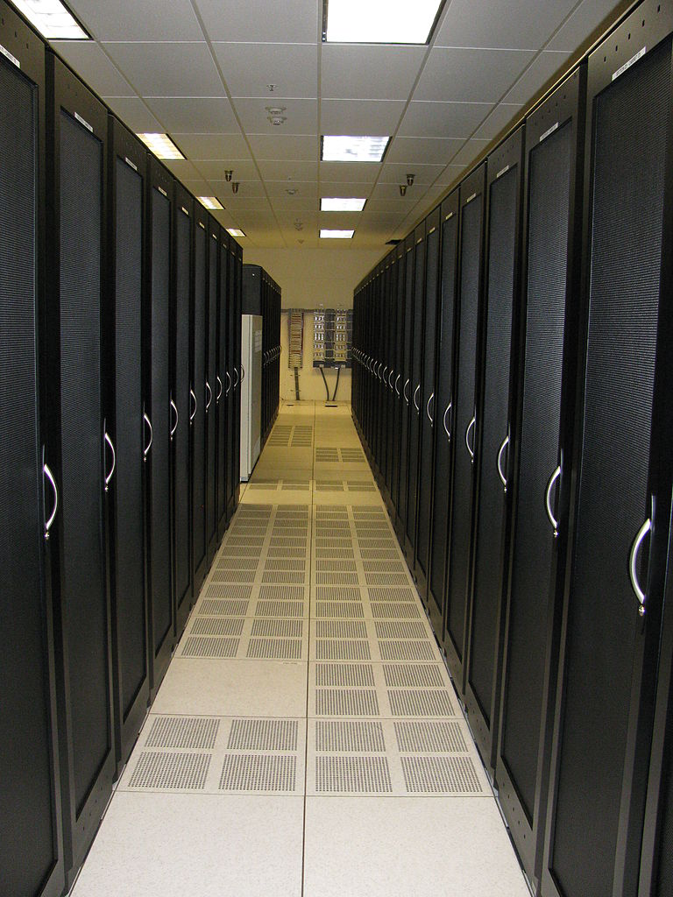

Slide 44
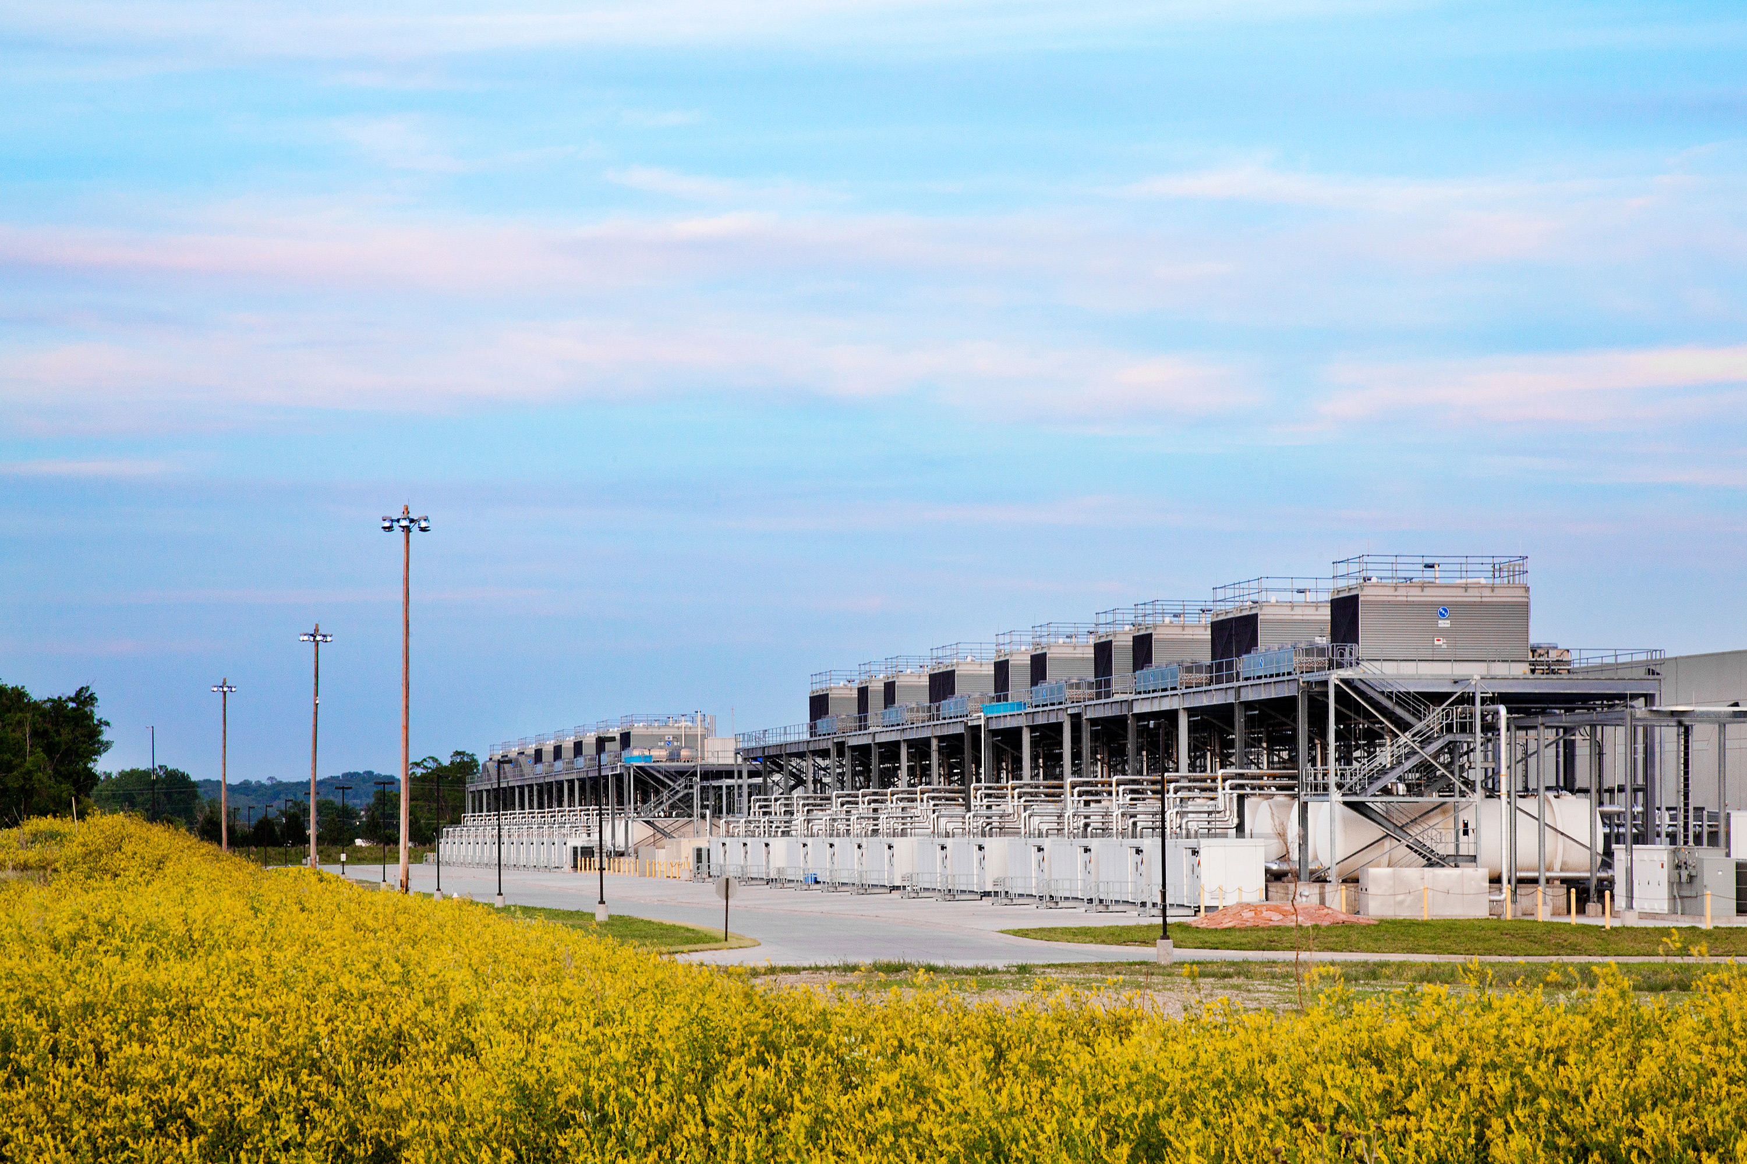

Slide 45
Computer Industry
App
App
App
App
App
App
App
App
App
App
App
Specialized
Applications
Open Interface
Specialized
Operating System
Windows
(OS)
Linux
Mac
OS
or
or
Open Interface
Specialized
Hardware
Microprocessor

Slide 46
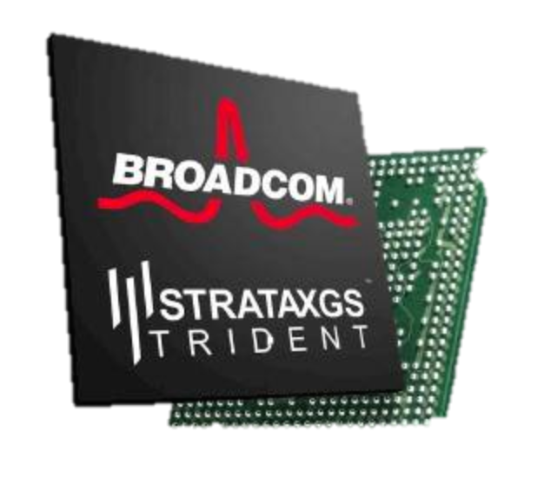
Networking Industry
App
App
App
App
App
App
App
App
App
App
App
Specialized
Features
Open Interface
NOX
Beacon
ONIX
POX
ONOS
Flood light
Trema
ODL
Ryu
Control Plane 1
Control Plane 2
Specialized
Operating System
Open Interface
Switch Chips
Specialized
Hardware

Slide 47
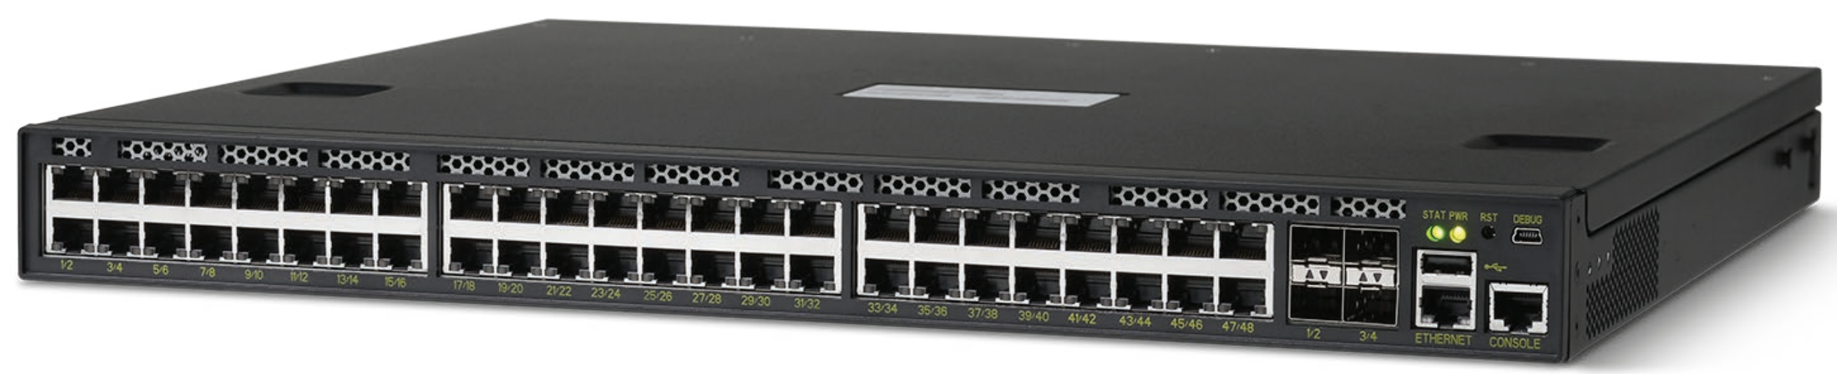
2010: The whitebox switch
Sheet metal
DRAM

Slide 48
Software
Software
Hardware
Software
Hardware
Software
Hardware
Hardware

Slide 49
Forwarding Plane
Software
Software
Hardware
Software
Hardware
Software
Hardware
Hardware

Slide 50
Control Plane
Software
Software
Hardware
Software
Hardware
Software
Hardware
Hardware

Slide 51
Software Control Plane
Software
Software
Hardware
Data
B
Software
Hardware
Software
Hardware
B
Hardware

Slide 52
Software Defined Network
A network in which the control plane is physically separate from the forwarding plane.
and
A single control plane controls several forwarding devices.
(That’s it)

Slide 53
Software Control Plane
SDN:
Forwarding
Forwarding
Forwarding
Forwarding
Immediate consequences...
Puts network owners and operators in control of their destiny.
Networks are more reliable and more secure.
Networks cost less: hardware is simple and streamlined again.
Networks cost less to operate: customized.

Slide 54
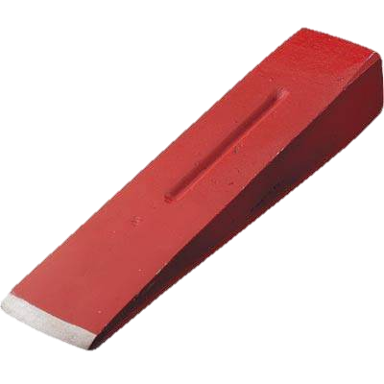
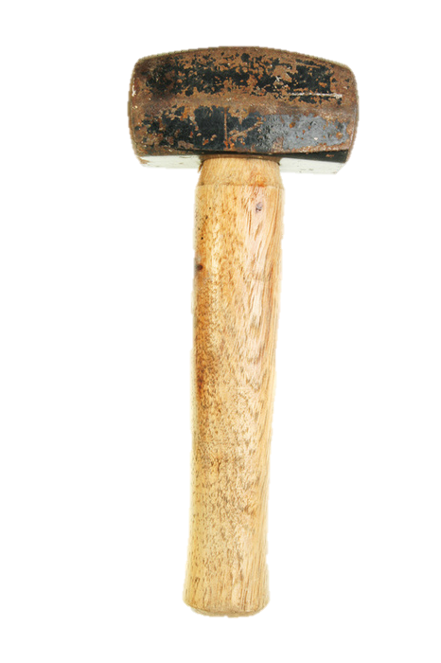
OpenFlow specification
Startup company (Nicira)
200 universities
Open Networking Foundation (ONF)
Control Program
Global Network Map
Network Operating System
Software
Very simple hardware
OpenFlow
Forwarding
Forwarding
Forwarding
Forwarding

Slide 55
Chapter 3: The technical rationale for SDN

Slide 56
What routers do Route packets to the correct destination

Slide 57
B
A

Slide 59
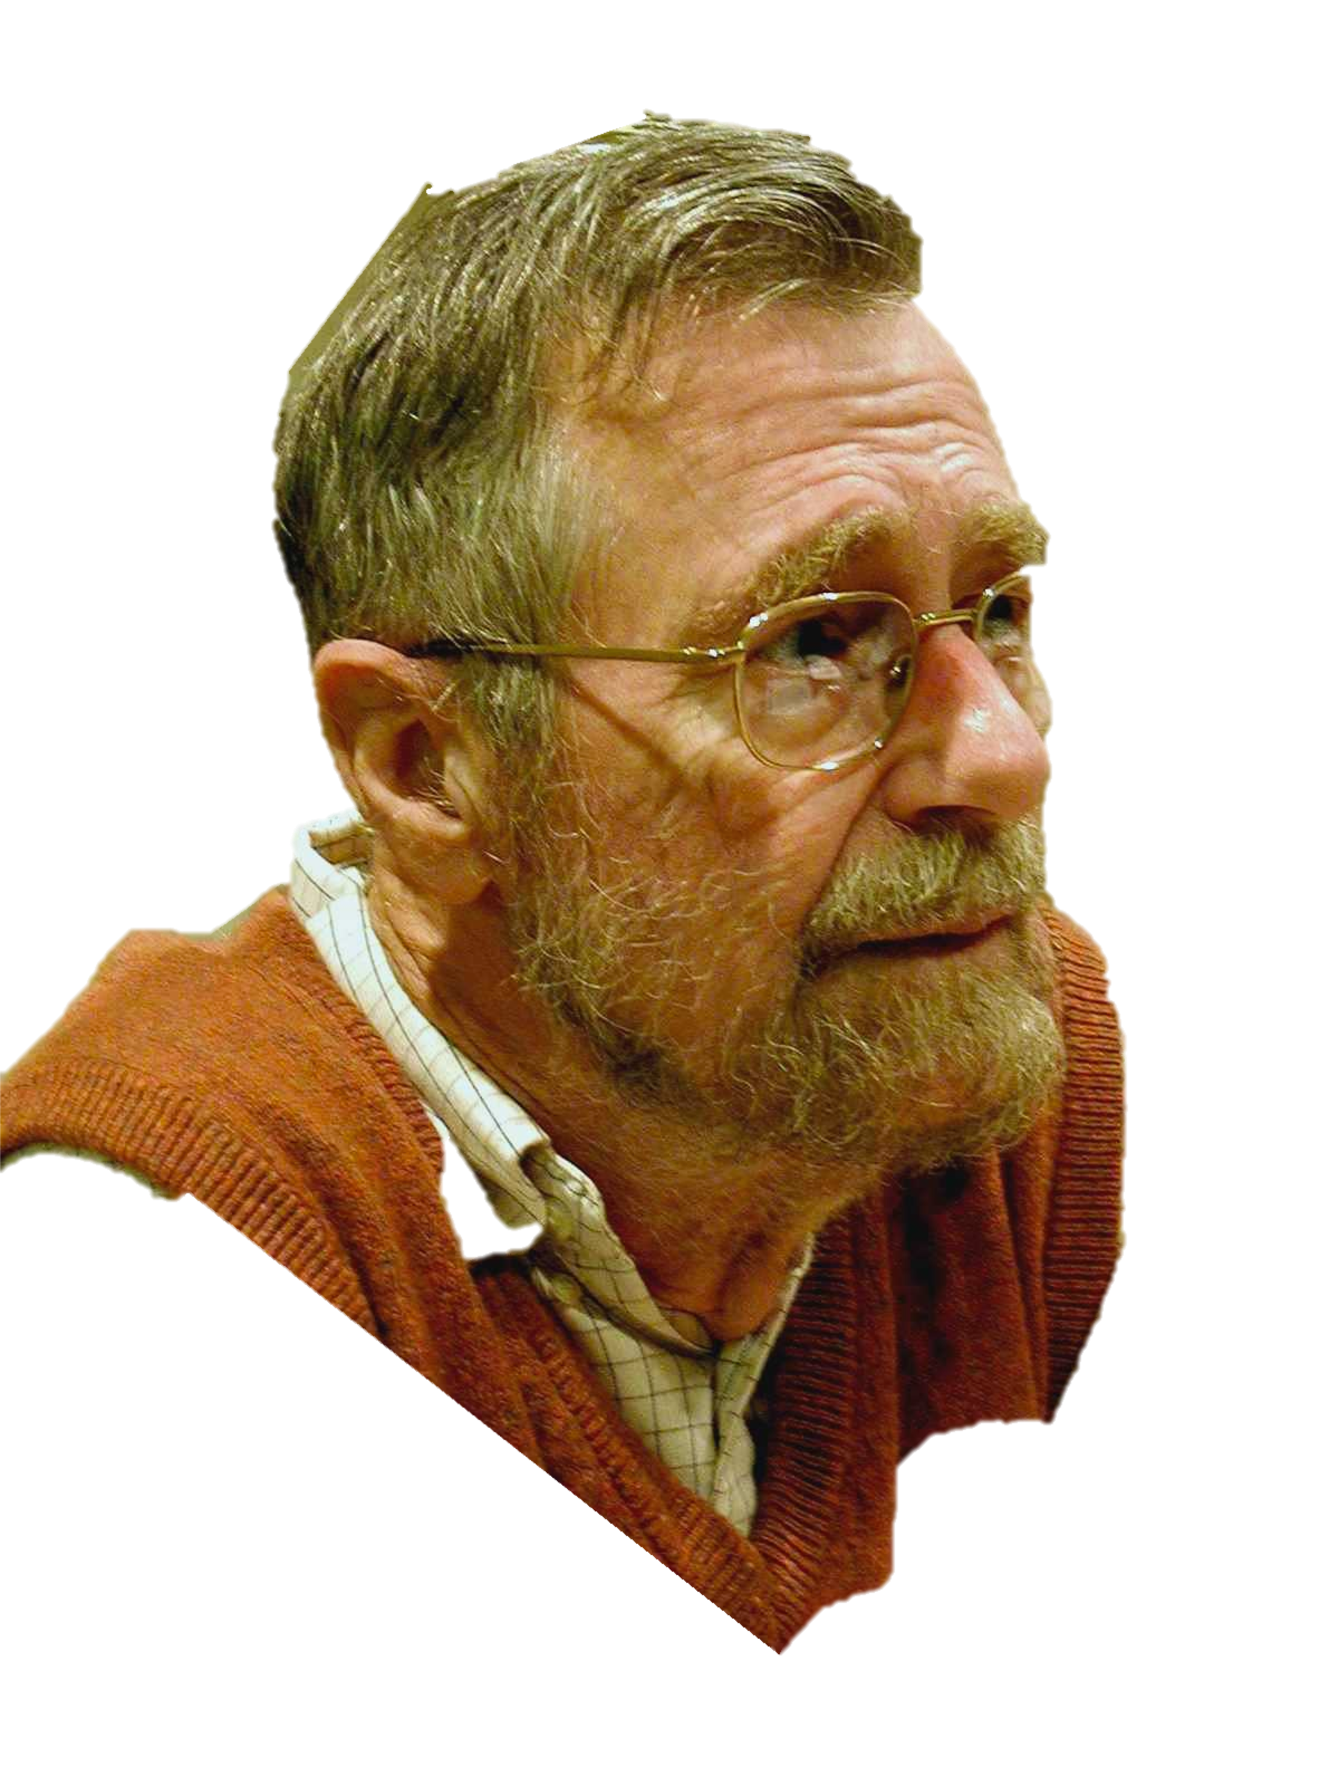
function Dijkstra(Graph, source):
for each vertex v in Graph:
dist[v] := infinity ;
previous[v] := undefined;
dist[source] := 0 ;
Q := the set of all nodes in Graph ;
while Q is not empty: // The main loop
u := vertex in Q with smallest distance in dist[] ;
remove u from Q ;
if dist[u] = infinity:
break ;
for each neighbor v of u:
alt := dist[u] + dist_between(u, v) ;
if alt < dist[v]:
dist[v] := alt ;
previous[v] := u ;
decrease-key v in Q;
return dist[], previous[];
end function
Edsger Dikjstra
1930-2002
Photo: Hamilton Richards

Slide 60
A
B
The Opte Project

Slide 61
Software
Software
Hardware
Software
Hardware
Software
Hardware
Hardware

Slide 62
Figure out which routers and links are present.
Run Dijkstra’s algorithm to find shortest paths.
B
“If a packet is going to B, then send it to output 3”
Software
Software
Hardware
Data
B
2
Software
1
Hardware
B
“If , send to 3”
Hardware
B
Software
3
Hardware

Slide 63
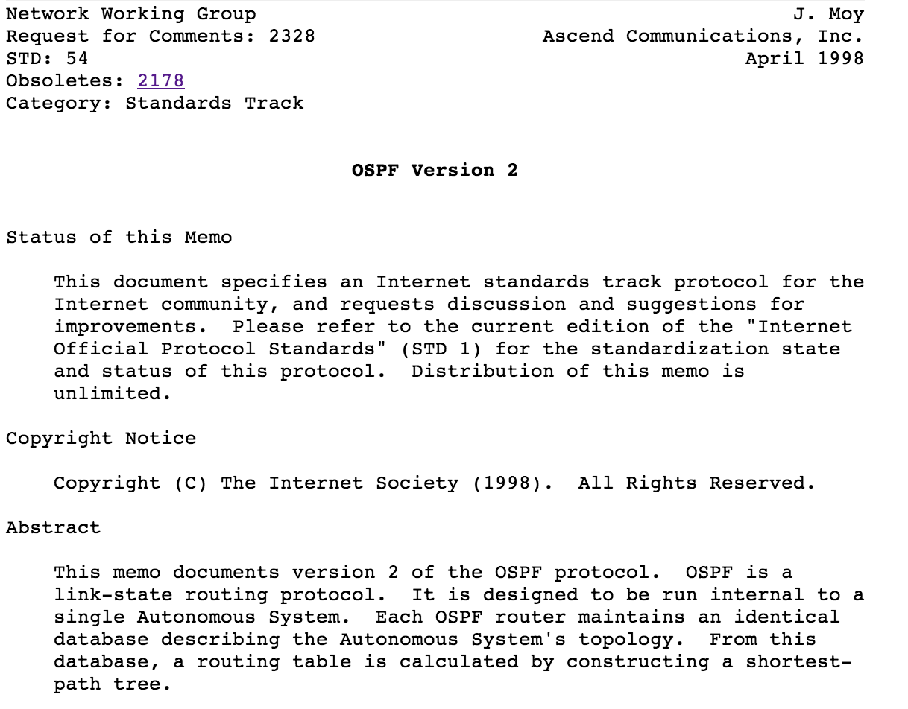
95%
Figure out which routers and links are present.
Run Dijkstra’s algorithm to find shortest paths.
5%
Software
Software
Hardware
2
Software
1
Hardware
B
“If , send to 3”
Hardware
B
Software
3
Hardware

Slide 64
95%
Figure out which routers and links are present.
Run Dijkstra’s algorithm to find shortest paths.
5%
50,000 lines of code
50,000 lines of code
Software
Software
50,000 lines of code
Hardware
Software
Hardware
Software
Hardware
Hardware
Building a reliable distributed system is really hard!

Slide 65
Dijkstra
IS-IS
BGP
MPLS
Firewall…
Global Network Map
Network OS
Forwarding
Forwarding
Forwarding
Forwarding

Slide 66
Chapter 4: How is SDN being used?

Slide 67
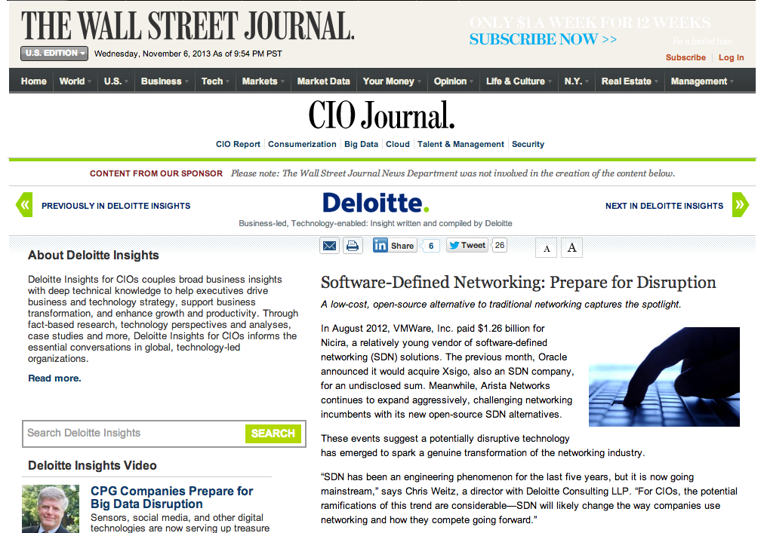
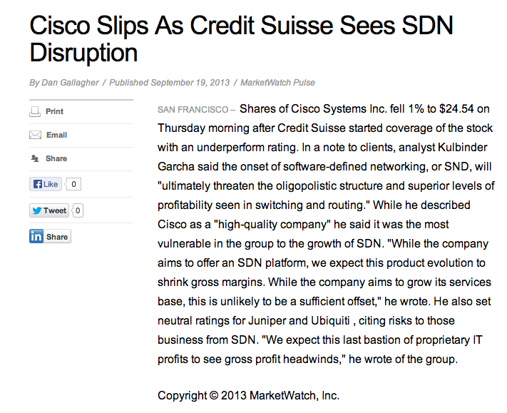
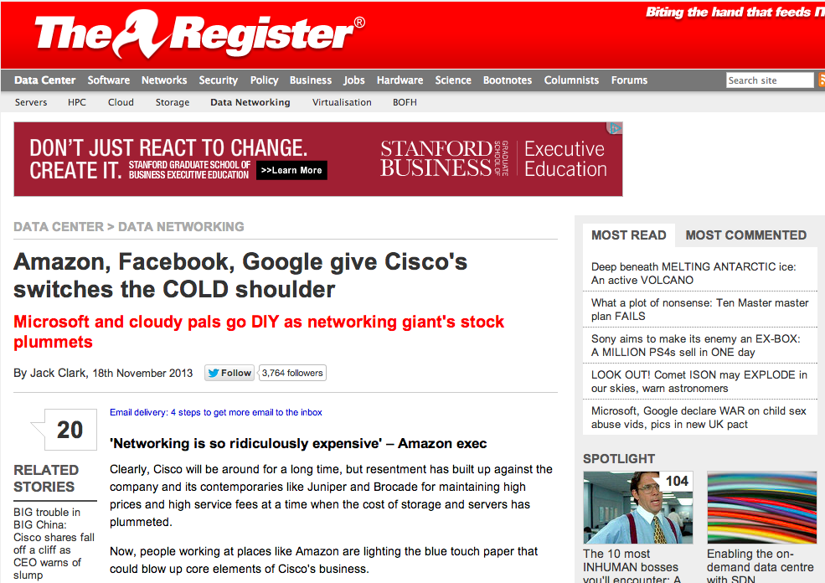

Slide 68
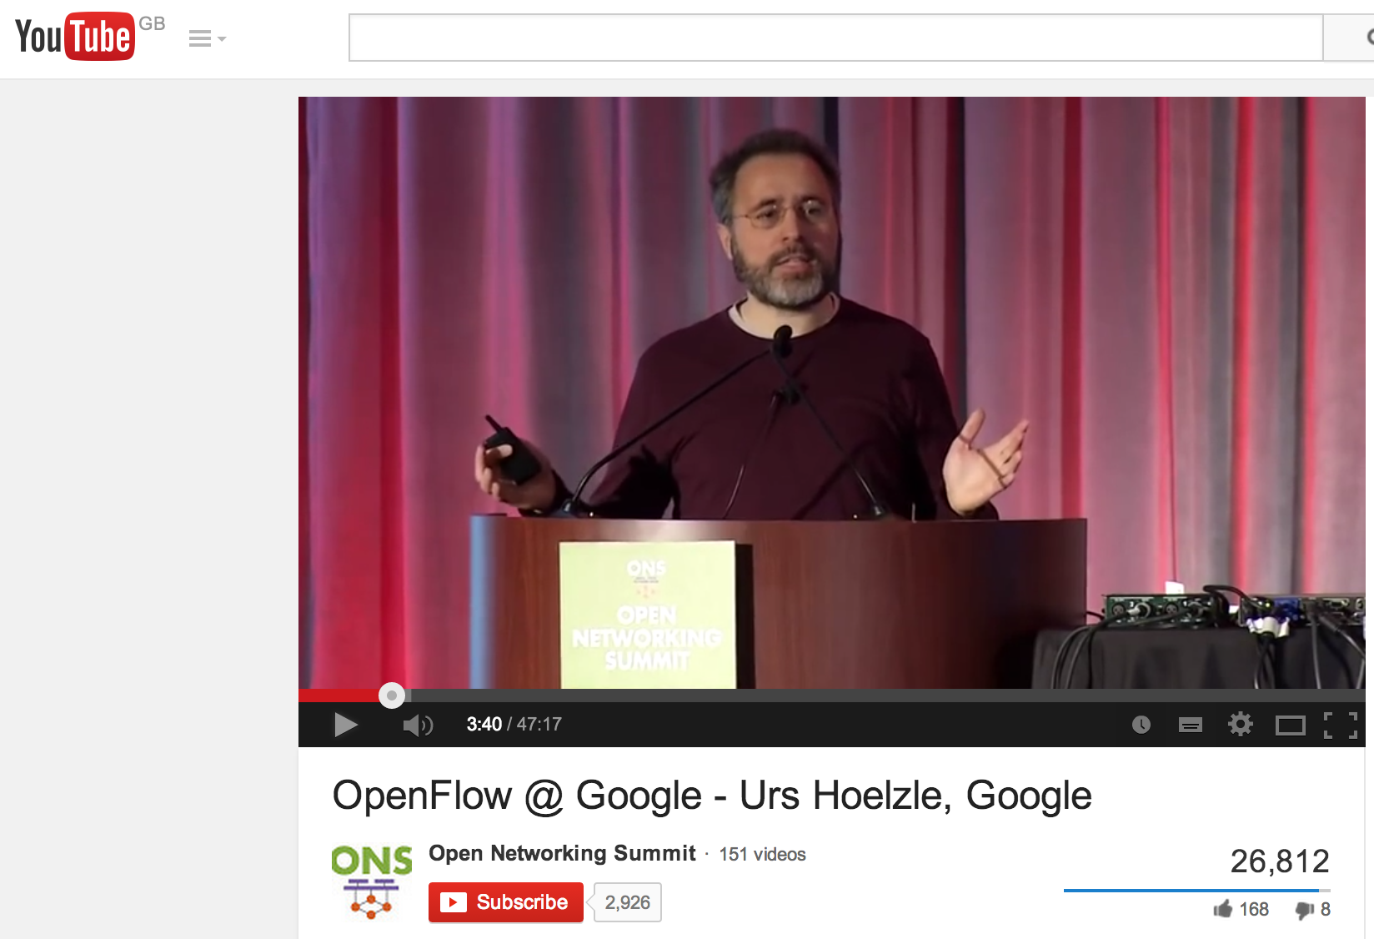
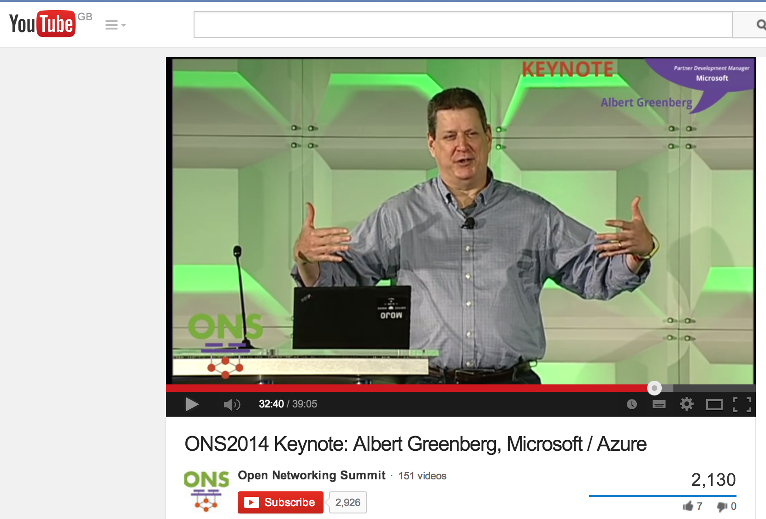
Today’s deployments
Inter data center networks
Intra data center networks
Google
Microsoft

Slide 69
Upcoming deployments
Public service provider networks (AT&T, NTT, China Telecom, DT, BT, …)
Enterprise and campus networks
WiFi networks
Cellular networks
Home networks

Slide 70
Researchers can now try out new ideas in the Internet, at scale

Slide 71
Problem
Many good research ideas on college campuses…
No way to test new ideas at scale, on real networks, with real user traffic
Consequence: Almost no technology transfer
With SDN, this is changing very rapidly...

Slide 72
Research Example #1 Load-balancing as a network primitive
Nikhil Handigol, Mario Flajslik, Srini Seetharaman

Slide 73











Slide 74
Experiment
Nationwide experiment: 500 lines of code
Global Network Map
Network OS
Forwarding
Forwarding
Forwarding
Forwarding

Slide 75
Research Example #2 Using all the wireless capacity around us
KK Yap, Masayoshi Kobayashi, Yiannis Yiakoumis, TY Huang

Slide 76


Slide 77
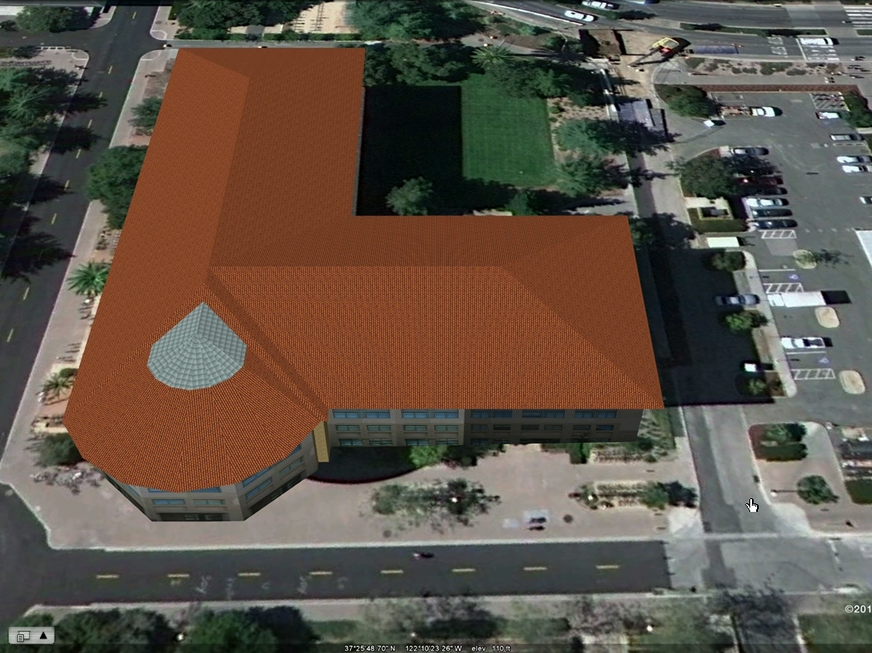
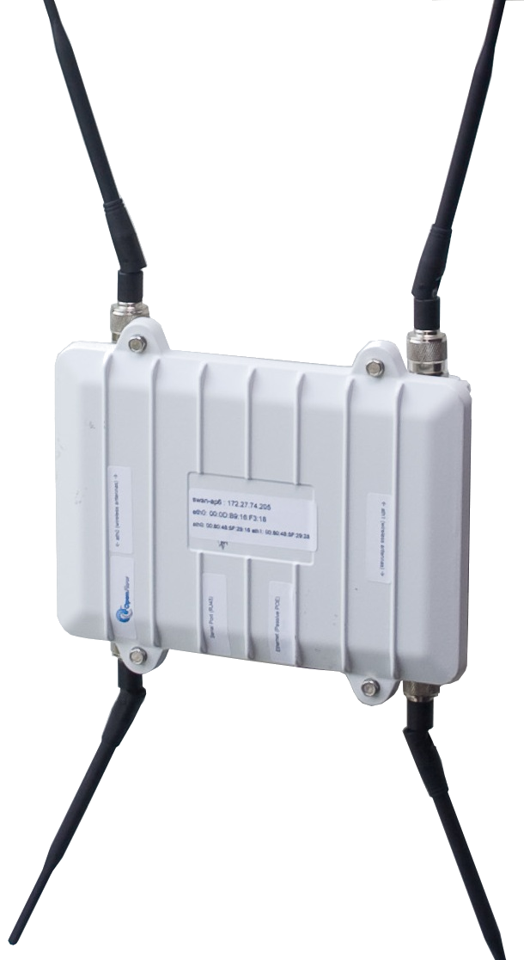
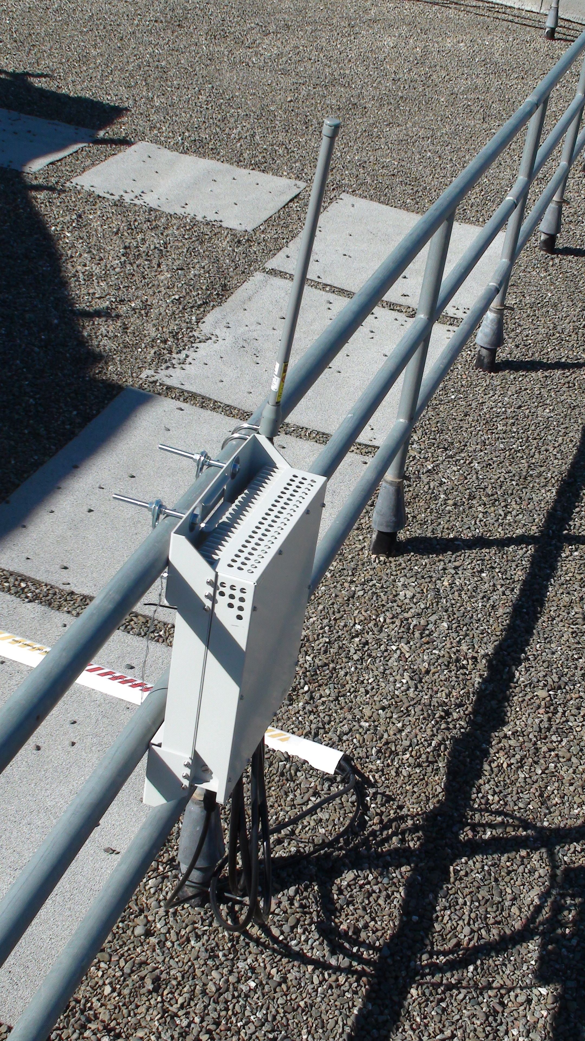
KK’s Experiment
<250 lines of code
Network OS
WiMax

Slide 78
More videos openflow.org/videos

Slide 79
Chapter 5: What’s next?

Slide 80
What’s next?
Networks will be virtualized.
Network behavior will be provably correct.
Software defined networks will run on programmable hardware.

Slide 81
What’s next?
Networks will be virtualized.
Network behavior will be provably correct.
Software defined networks will run on programmable hardware.

Slide 82
Control
Control
Forwarding
Data
B
2
Control
1
Hardware
B
“If , send to 3”
Forwarding
B
Control
3
Forwarding
All the rules are in the Forwarding Plane – possibly millions.
How did the rules get there?

Slide 83
Software
Software
Hardware
Software
Hardware
Software
Hardware
Hardware
Conventionally: Lots of features and protocols populate the tables.
Forwarding rules neither observable or controllable.

Slide 84
Well-defined roles and abstractions means we can mathematically prove correctness across boundaries.
Control Program
Global Network Map
Network Operating System
B
“If , send to 3”
Forwarding
Forwarding
Forwarding
Forwarding

Slide 85
What’s next?
Networks will be virtualized.
Networks will be more reliable.
Software defined networks need to run on programmable hardware.

Slide 86
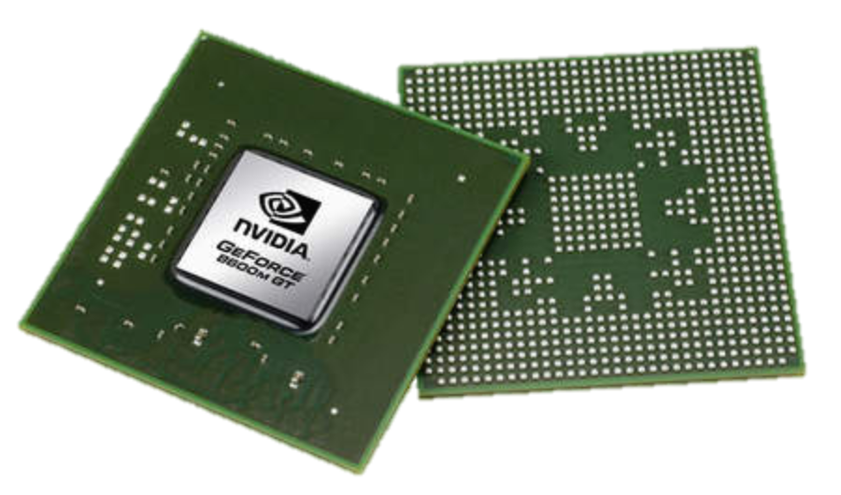
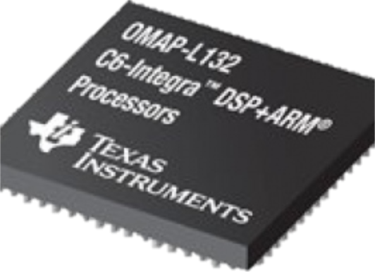
Software Defined Everything
Cellular Base Stations
Computers
Graphics
Software
Software
Software
CPU
GPU
DSP

Slide 87
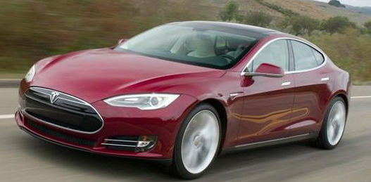
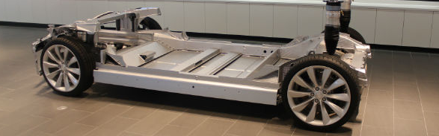
Software Defined Everything
Self-driving car
Software

Slide 88
Software Defined Everything
Cellular Base Stations
Networks
Computers
Graphics
Software
Software
Software
Software
?
CPU
GPU
DSP
“TBD”

Slide 89
Summary
Well-functioning plumbing should be invisible.
The Internet plumbing became too complex to be invisible.
SDN:
Is inevitable – for business and technical reasons
Will make networks cheaper
Will place control in the hands of network owners and operators
Networks will be come more reliable and more secure
…and invisible.

